Slide 1

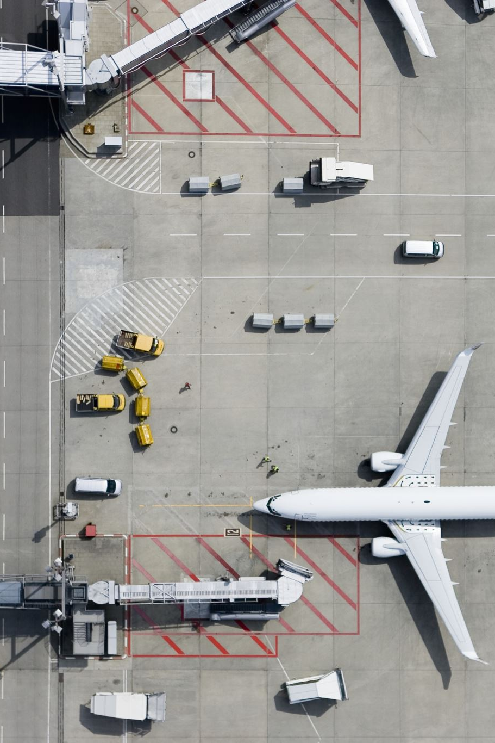
Flight Delay Prediction
Goal: Predict if a flight is delayed
Delay = arrival > 15 minutes
Dataset: 3M rows (sampled to 200K)

Slide 2
Features & Data Prep
Removed leakage (post-flight data)
Created features: time, peak hour, route frequency
Encoded categorical variables

Slide 3
Model Comparison
SGD: High recall, overpredicts
Random Forest / GB: High accuracy, low recall
XGBoost: Best balance

Slide 4
Threshold Tuning
Default 0.5 → more delay predictions
Used 0.6 → more balanced
Shows tradeoff: recall vs precision

Slide 5
App & Conclusion
Built Gradio app for predictions
XGBoost used for deployment
Future: add weather + real-time data

